Slide 1


Introduction to internet of things
Maka..pemikiran dan kehidupan anda akan berubah selepas mengetahui ilmu yang evergreen ini. Selesakan diri anda....Nantikan dan rasai perubahannya...

Slide 2
Course Content
Topic 1:
Node-RED
What is Node-RED?
Browser-based flow editing
FRED – Online Node-RED
Simple Flow
Topic 2:
MQTT
What is MQTT?
Send Data through MQTT
Configure MQTT Broker
Exercises:
Exercise 1
Exercise 2
Slide 2 of 35

Slide 3
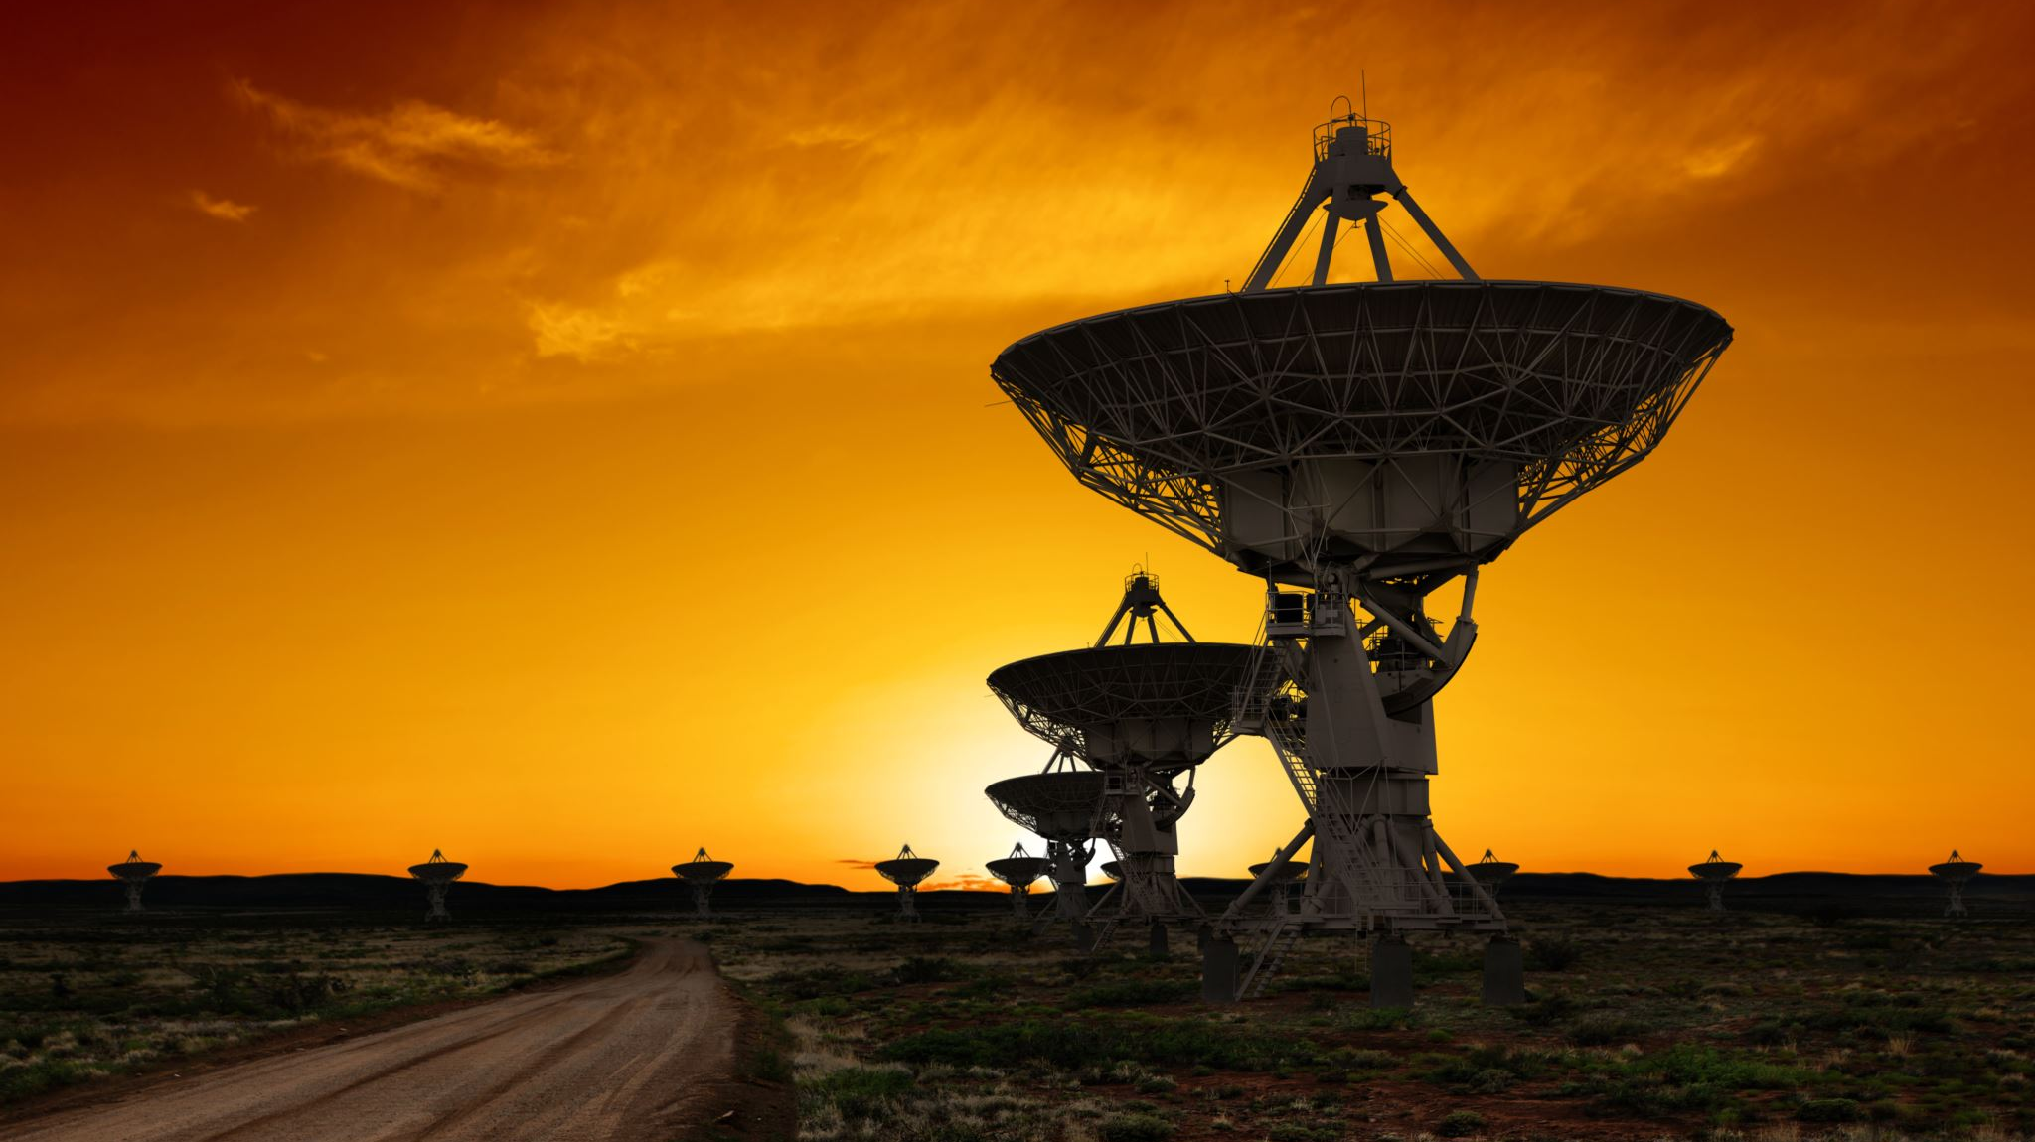
What is Node-RED?
Topic 1: NODE-RED
Slide 3 of 35

Slide 4

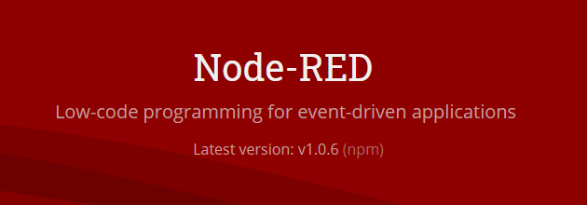
Node-RED is a programming tool for wiring together hardware devices, APIs and online services in new and interesting ways.
It provides a browser-based editor that makes it easy to wire together flows using the wide range of nodes in the palette that can be Deployed to its runtime in a single click.
Slide 4 of 35

Slide 5
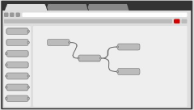
Browser-based flow editing
• Node-RED provides a browser-based flow editor that makes it easy to wire together flows using the wide range of nodes in the palette. Flows can be then deployed to the runtime in a single-click.
• JavaScript functions can be created within the editor using a rich text editor.
• A built-in library allows you to save useful functions, templates or flows for re-use.
Slide 5 of 35

Slide 6
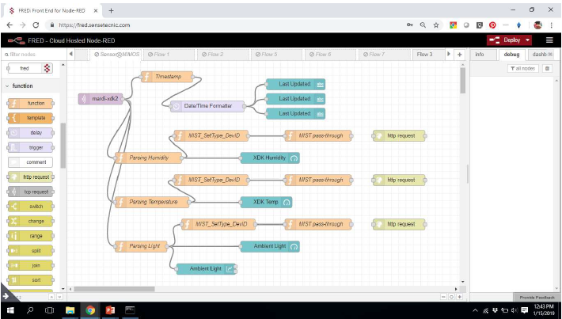
Slide 6 of 35

Slide 7
FRED – Online Node-RED
• Now, for Node-Red, you can choose to install it on your PC or just use the cloud-based.
• Cloud-based is at https://fred.sensetecnic.com/
• Node-RED provides a browser-based flow editor, which can be used to create JavaScript functions. The runtime is built on Node.js. The flows created in Node-RED are stored using JSON.
• Front End for Node-RED (FRED) manages instances of Node-RED for multiple users in the cloud. To instantly create your own Node-RED instance, register for a free (limited) account, or check out the pricing for hosting your instance of Node-RED.
Slide 7 of 35

Slide 8
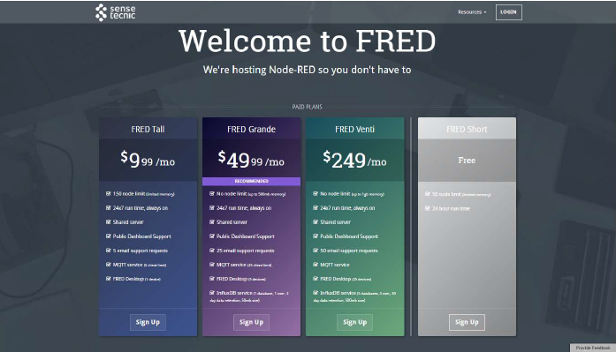
Register FREE with FRED
https://fred.sensetecnic.com
Slide 8 of 35

Slide 9
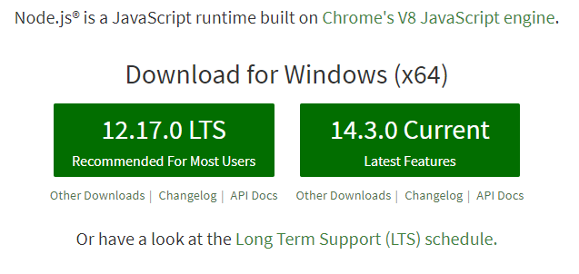
You can install Node-Red on your PC
Need to download Node.JS at Node.js home page
Then install the LTS .msi version.
Slide 9 of 35

Slide 10
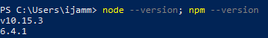
Quick Start
Once installed, open a command prompt and run the following command to ensure Node.js and npm are installed correctly.
Using Powershell: node --version; npm --version
Using cmd: node --version && npm –version
You should receive back output that looks similar to:

Slide 11
Install Node-RED
Installing Node-RED as a global module adds the command node-red to your system path. Execute the following at the command prompt:
Run Node-RED:-
Once installed, you are ready to run Node-RED.

Slide 12
Simple Flow
Slide 12 of 35

Slide 13
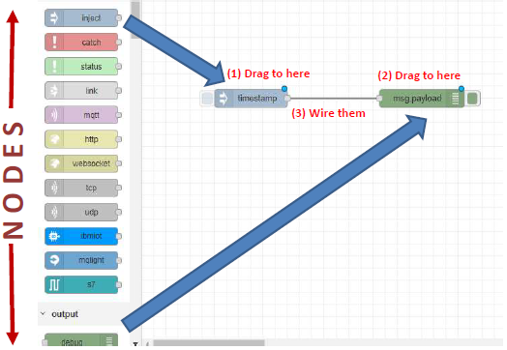
Slide 13 of 35

Slide 14
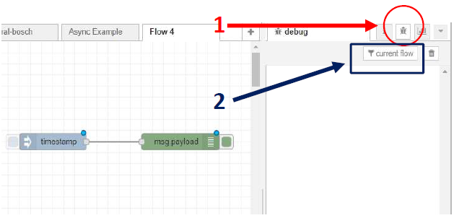
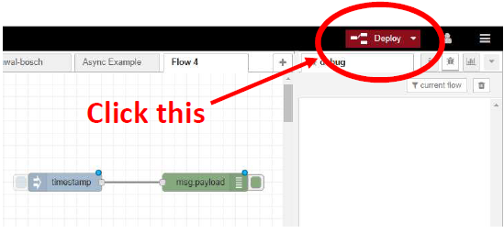
Deploy
Slide 14 of 35

Slide 15
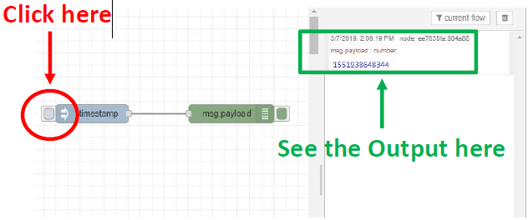
Your design flow is now ready, test it!
Slide 15 of 35

Slide 16
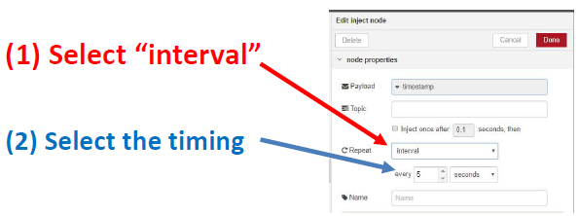
How to repeat the task?
Double click at the “timestamp” node
Slide 16 of 35

Slide 17
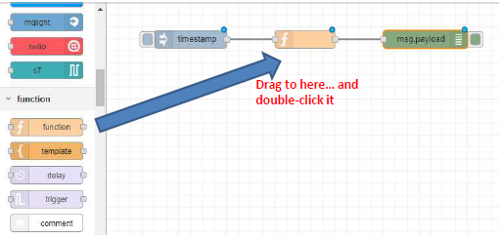
Overwrite with your own message
Use a “function” Node.
Slide 17 of 35

Slide 18
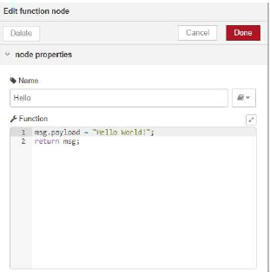
Change msg.payload
Add some text as below and see the results.
Slide 18 of 35

Slide 19

Topic 2: MQTT
What is MQTT?
Slide 19 of 35

Slide 20
What is MQTT?
MQTT - Message Queuing Telemetry Transport
MQTT is a machine-to-machine (M2M)/"Internet of Things" connectivity protocol. It was designed as an extremely lightweight publish/subscribe messaging transport. It is useful for connections with remote locations where a small code footprint is required.
It has been used in sensors communicating to a broker via satellite link, over occasional dial-up connections with healthcare providers, and in a range of home automation and small device scenarios. It is also ideal for mobile applications because of its small size, low power usage, minimized data packets, and efficient distribution of information to one or many receivers.
Slide 20 of 35

Slide 21
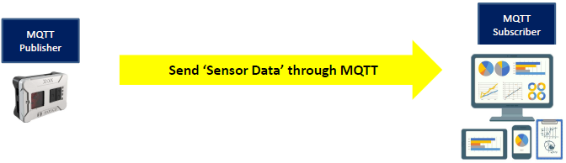
Send Data through MQTT
Slide 21 of 35

Slide 22
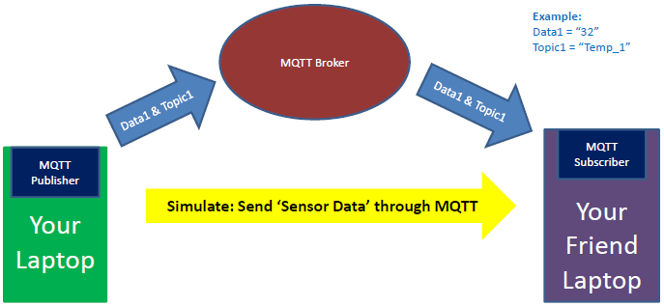
Simple Diagram for IoT - MQTT
Slide 22 of 35

Slide 23
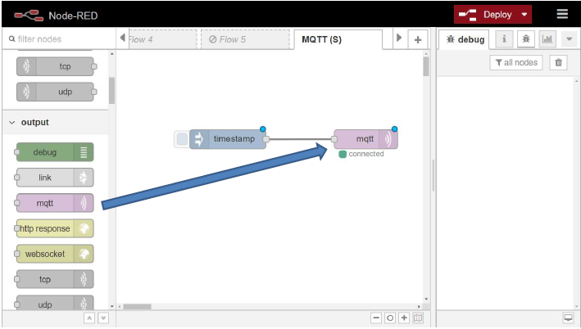
Create the Flow : Your Laptop
Slide 23 of 35

Slide 24
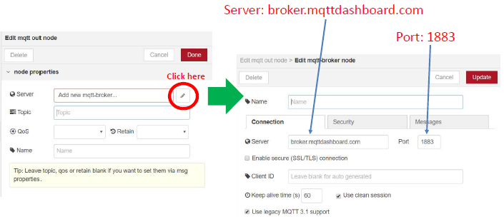
Configure MQTT Broker
Slide 24 of 35

Slide 25
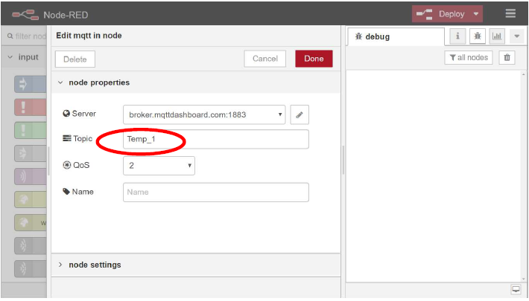
Slide 25 of 35

Slide 26
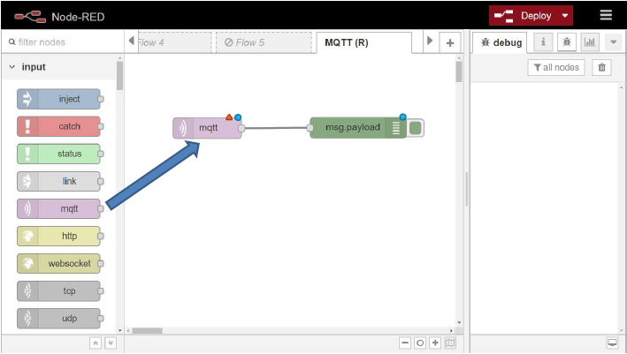
Create the Flow : Your Friend Laptop
Slide 26 of 35

Slide 27
LET’S TRY SOME EXERCISES Exercise 1:
In your FRED, create a new Flow (Work with your friend)
Person #1:- Use MQTT output to ‘publish’ data, with a ‘topic’
Person #2:- Use MQTT input to ‘subscribe’ to the data (using same ‘topic’)
Server: broker. mqttdashboard.com
Port: 1883
Slide 27 of 35

Slide 28
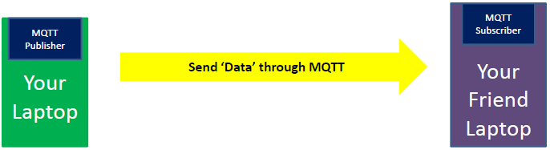
Exercise 1:
Slide 28 of 35

Slide 29
Let’s try another exercise… Exercise 2??
Slide 29 of 35

Slide 30
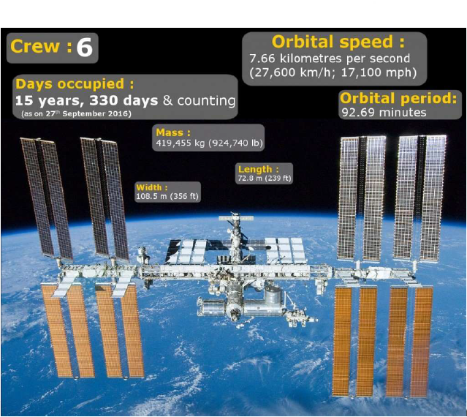
Where is the International Space Station (ISS)?
Slide 30 of 35

Slide 31
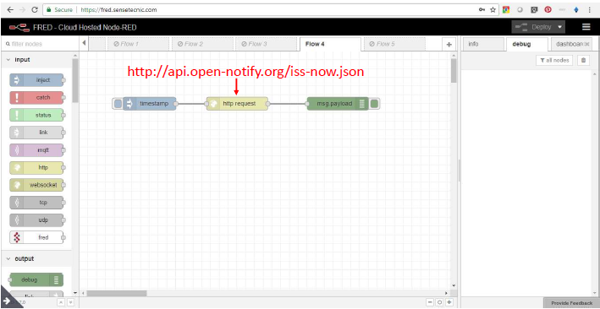
Exercise: Tracking ISS using Node RED
Latitude and Longitude
Slide 31 of 35

Slide 32
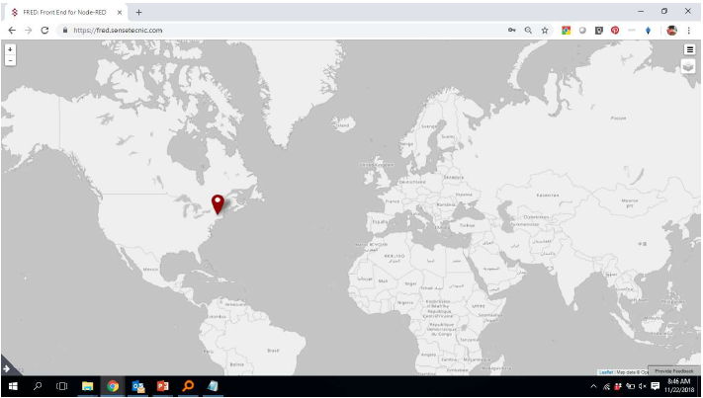
Display on Map?
Slide 32 of 35

Slide 33
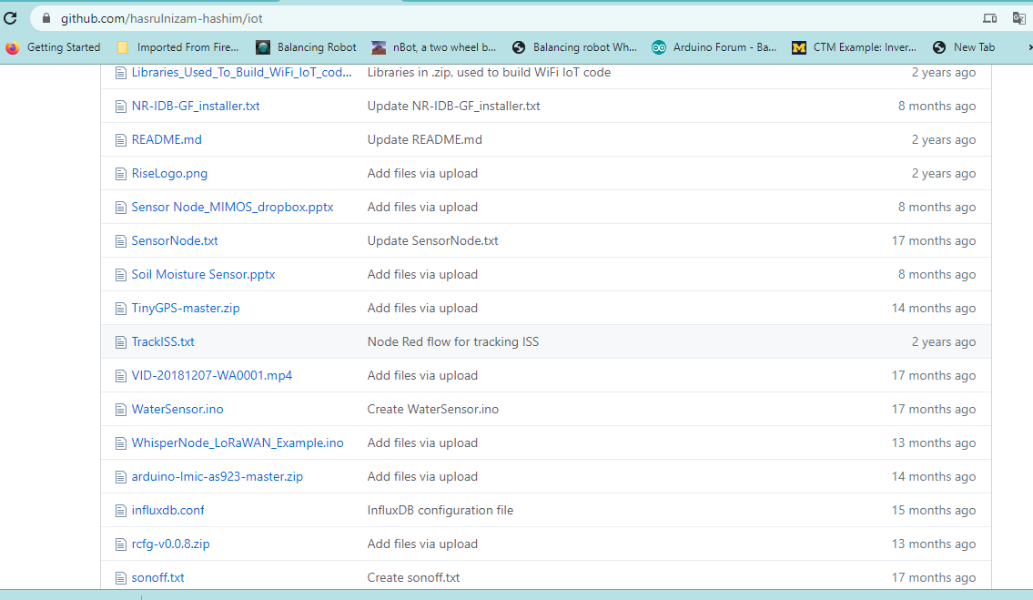
Get the “Flow” from here…
https://github.com/hasrulnizam-hashim/iot
Slide 33 of 35

Slide 34
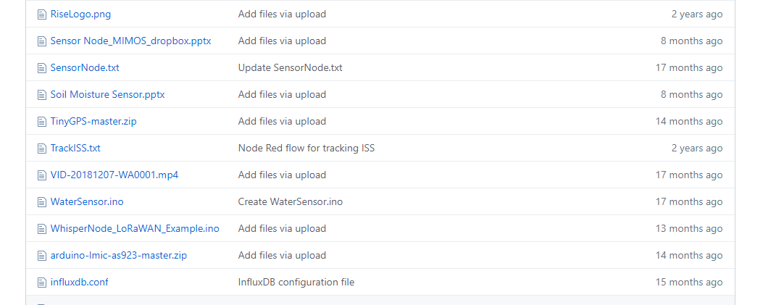
Click on “TrackISS.txt”

Slide 35
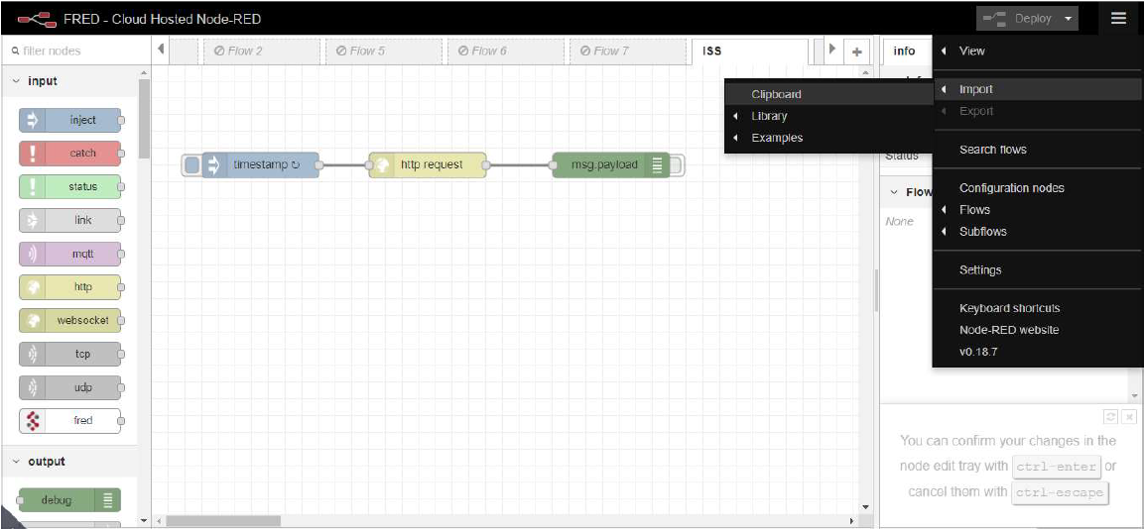
Finally… Import “Flow”

Slide 36
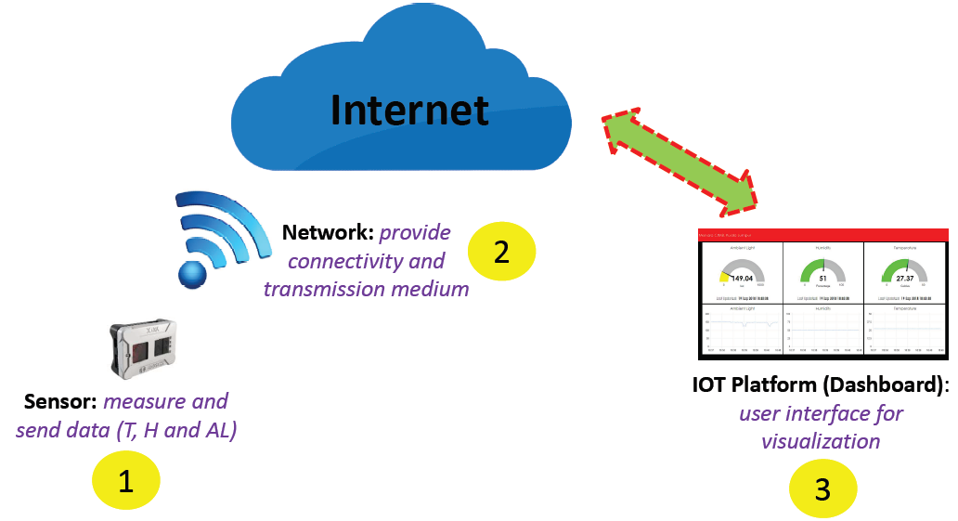
Next Session: Sensor, Network & Platform….
Slide 36 of 35

Slide 37



THANK YOU Terima kasih شكرا جزيلا
Any questions?

